Slide 1

MOBILE DEVELOPMENT
COMPUTER SCIENCE
Topic 2:
Mobile User Interface Design
version 1.0
Copyright © 2020 by Singapore Institute of Management Pte Ltd. All rights reserved.

Slide 2

Learning Outcomes
After studying this topic and the recordings online, you should be able to:
Topic 2 – Mobile User Interface Design
Importance of Design
Picking the right style
The 3 ways
Color palettes and mood psychology
Dark Patterns
Wireframing

Slide 3

The importance of design
Many mobile developers can't wait to get building, but before they start, they should know what needs to be built.
That really depends on what has already been designed.
For example, a builder doesn't start to build a house or a bridge before an architect has designed the structure.
Similarly, a mobile developer shouldn't build an application, without having a design to follow.
Notes:
B

Slide 4
The importance of design
So, firstly, what is a design?
In principle, a design is a plan or a drawing produced to show the look, function, or workings of a building, garment, or another object, before it is made.
Notes:
B

Slide 5
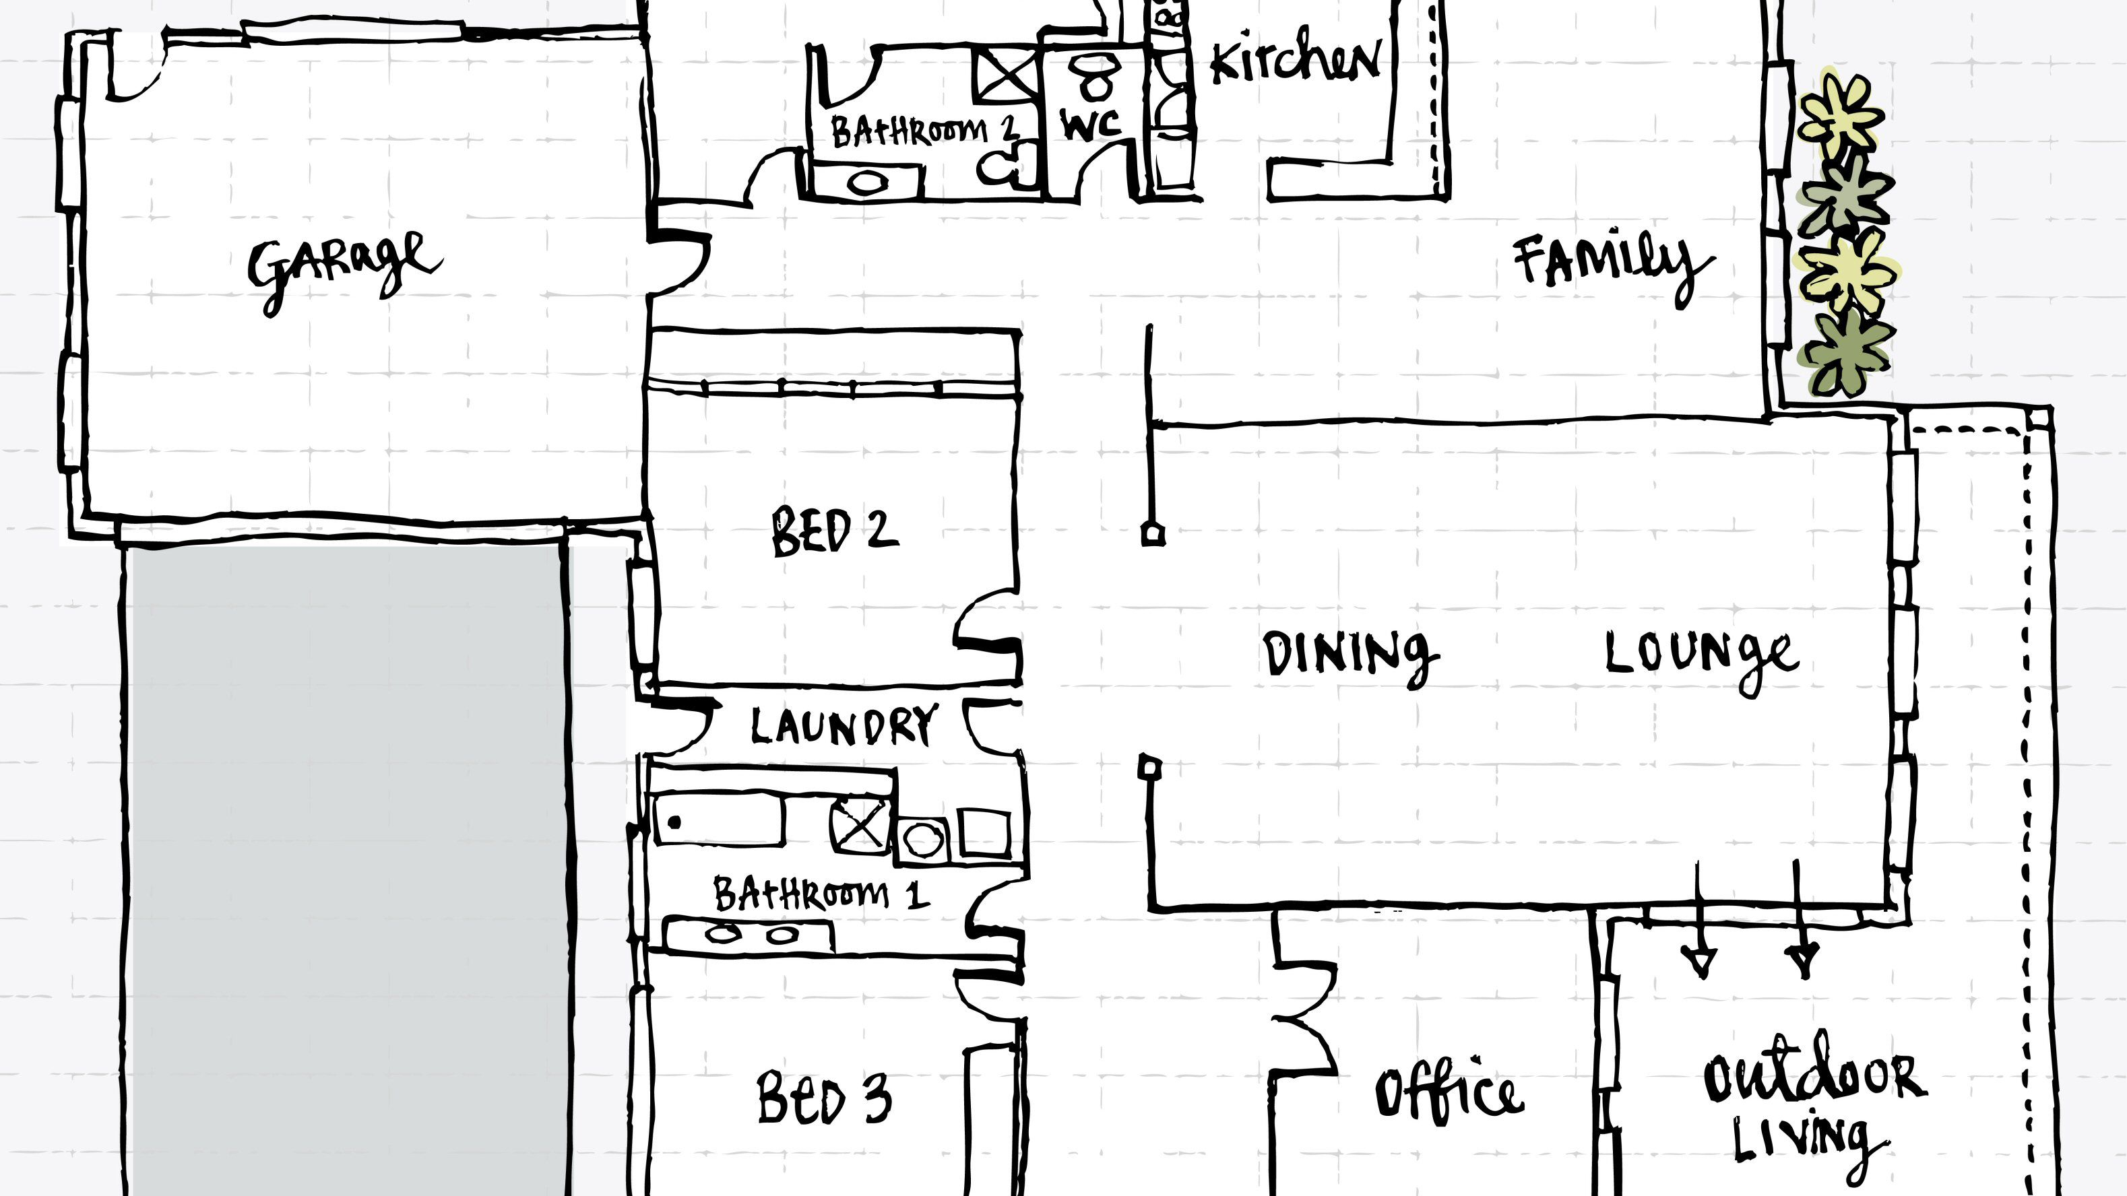
The importance of design
Let’s re-emphasize the FIVE (5) aspects of a design that are critical for mobile developers.
A plan should be laid out in the form of a drawing.
Notes:
B

Slide 6
The importance of design
Let’s re-emphasize the FIVE (5) aspects of a design that are critical for mobile developers.
The design should show the form and function of the mobile application, and finally they should all be completed before the aplication has started to be built.
Notes:
B

Slide 7
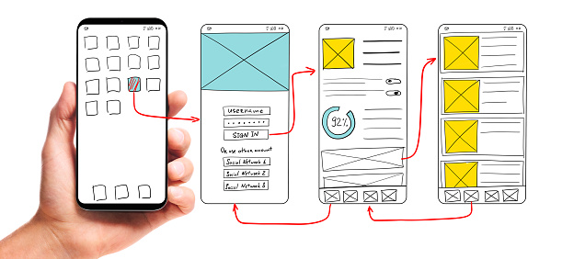
The importance of design
Notes:
B

Slide 8
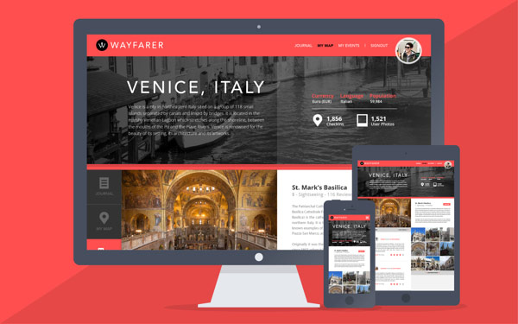
The importance of design
Let’s re-emphasize the FIVE (5) aspects of a design that are critical for mobile developers.
Ideate, propose a conceptual design that will meet the specification to the satisfaction of the stakeholders.
Notes:
B

Slide 9
The importance of design
Let’s re-emphasize the FIVE (5) aspects of a design that are critical for mobile developers.
Next is the prototype. In this step you need to build an initial version of the application, that has all the required functionality.
Notes:
B

Slide 10
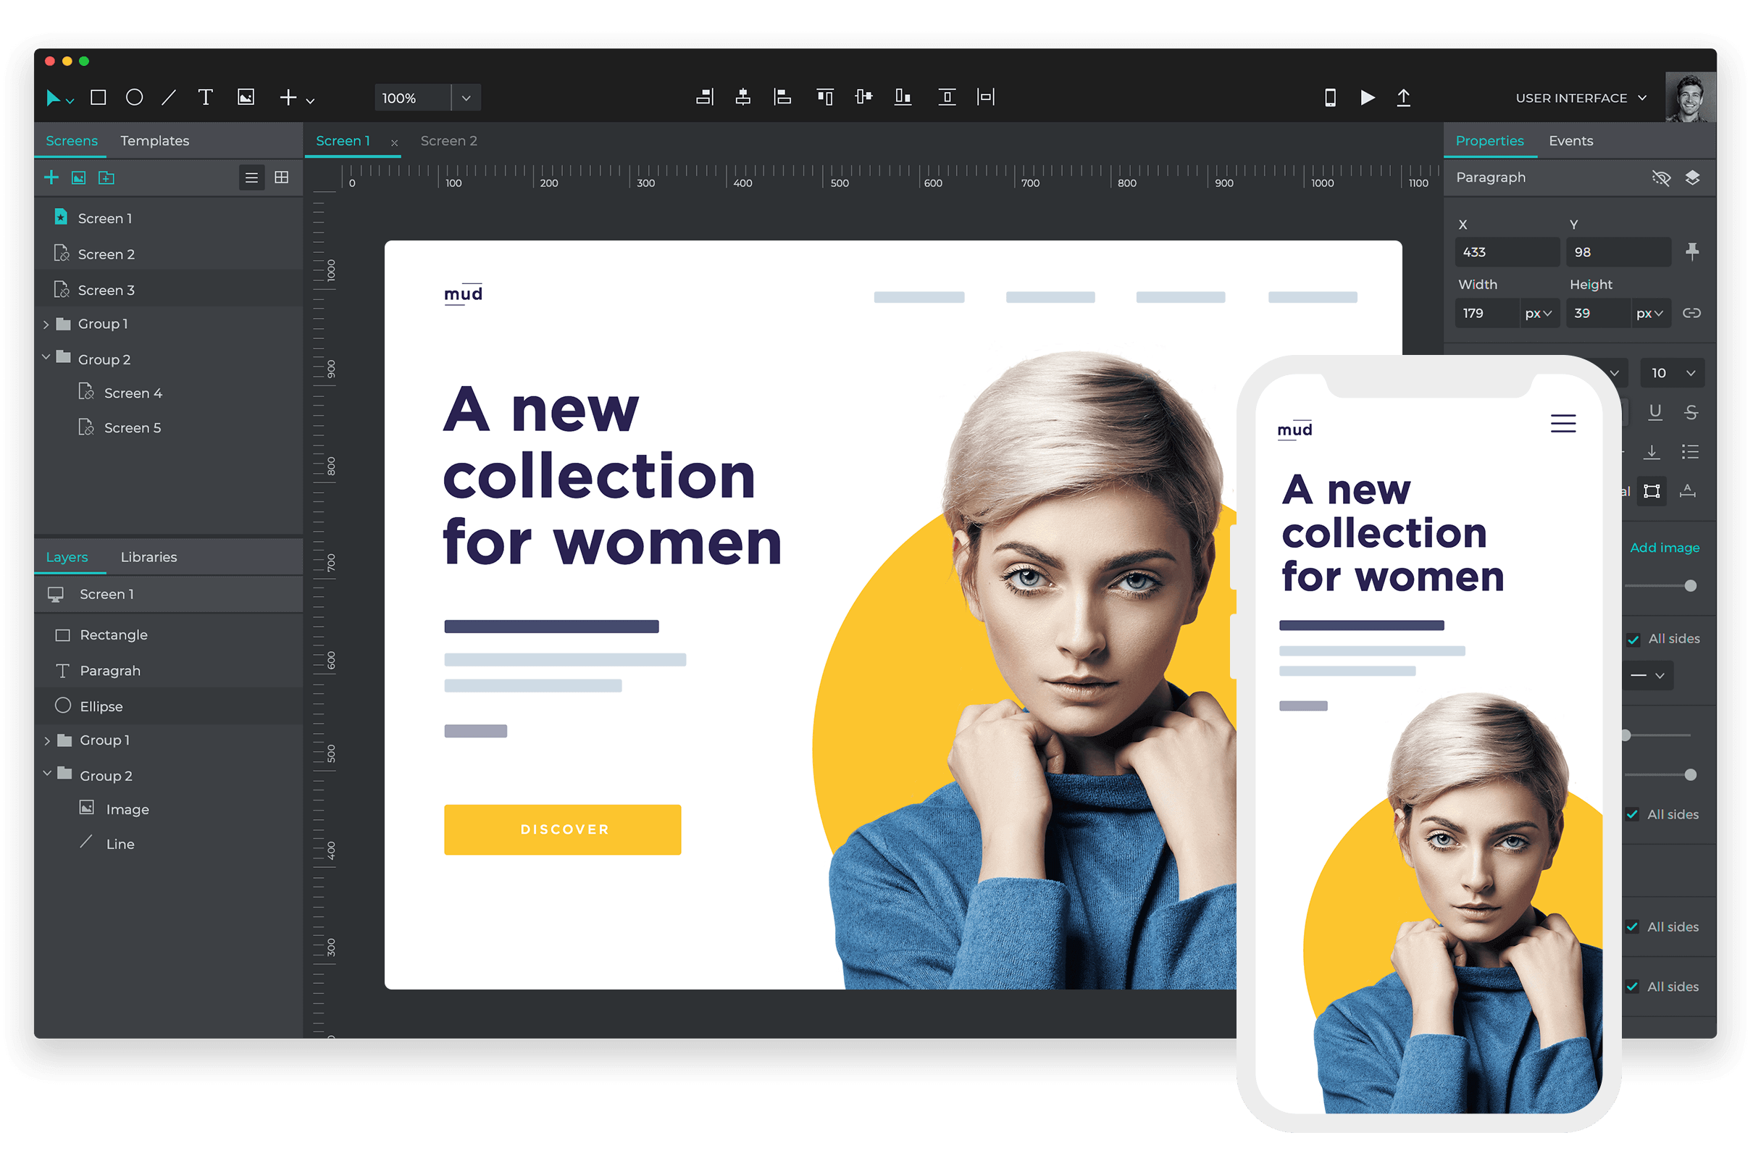
The importance of design
Notes:
B

Slide 11
The importance of design
Let’s re-emphasize the FIVE (5) aspects of a design that are critical for mobile developers.
Finally, remember to test it, work with the stakeholders to validate, that the outcome does indeed, meet the specification, and that the specifications are an accurate reflection of the requirements of the stakeholders.
Notes:
B

Slide 12
The importance of design
Now that you can see them working, in the prototype application.
This may be refined by running through the define, ideate, prototype and test phases, a number of times, until everyone agrees to move from the prototype, to the deployable site.
Notes:
B

Slide 13
The importance of design
A key goal in this process, is that an application is fit for purpose.
Something is fit for purpose if it is good enough to do the job it was designed to do.
However, it really depends on the following key points; that the purpose was identified, that the thing was designed, and that the thing does the job.
Notes:
B

Slide 14
Picking the right style
Choosing a design style of your app is an integral part of making it easy to use an attractive application.
Some thoughts that may occur:
Where do I start?
Where do I get the inspirations?
What are the current design trends?

Slide 15
Picking the right style
Most often, designs and styles are inspired from existing applications that are out in the market.
We pick the designs that we like and we follow through.
That’s why you see similar interfaces in some of the popular mobile applications.

Slide 16
The 3 Ways
In mobile development, we consider using the following 3 methods of choosing the right style:
Skeuomorphism
Minimalism
Neumorphism

Slide 17
The 3 Ways
Skeuomorphism
It is a term most often used in graphical user interface design to describe interface objects that mimic real-world counterparts in how they appear and/or how the user can interact with them.

Slide 18

The 3 Ways
Skeuomorphism
A well-known example is the recycle bin icon used for discarding files.

Slide 19
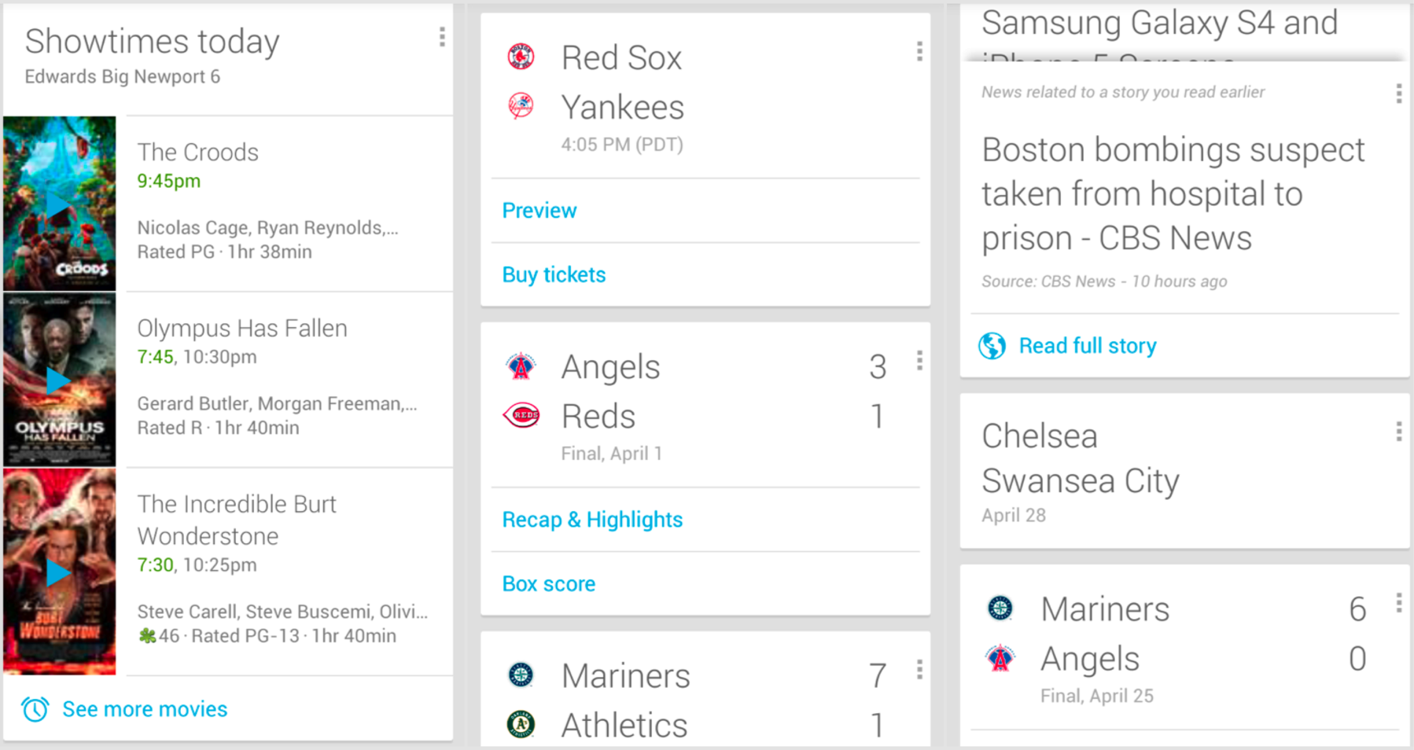
The 3 Ways
Skeuomorphism
Another great example in mobile application is the card interface.

Slide 20
The 3 Ways
Skeuomorphism
The earlier example relates to physical cards like:
Birthday cards
Business cards
Credit cards
Playing cards

Slide 21
The 3 Ways
2. Minimalism
At its core, minimalism means intentionally promoting the things we most value and removing everything that distracts us from it.
In the mobile context, it fits this metaphor perfectly.

Slide 22
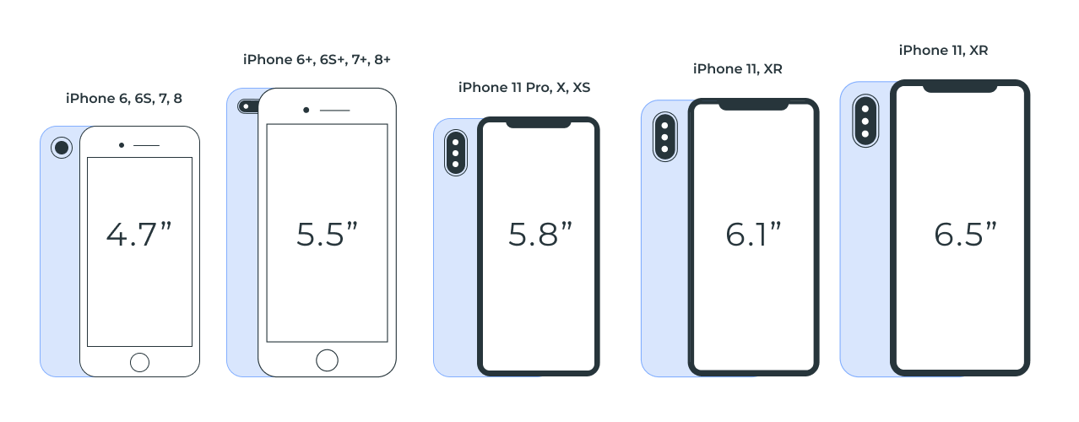
The 3 Ways
2. Minimalism
Most applications are used on a mobile smartphone and the screen sizes are vastly small.

Slide 23
The 3 Ways
2. Minimalism
So we need to consider prioritizing major/important functions to take up spaces on the main screen.
And consider functions that are less important to be hidden in sub-menus.

Slide 24
The 3 Ways
2. Minimalism
3 factors to consider:
Design for clarity
Put important functions first
Attention to design elements such as fonts, colors

Slide 25
The 3 Ways
3. Neumorphism
The next big thing!
It is a visual style that combines background colors, shapes, gradients, highlights, and shadows to ensure graphic intense buttons and switches.
All that allows achieving a soft, extruded plastic look, and almost 3D styling.

Slide 26
The 3 Ways
3. Neumorphism
This way, neumorphic cards, buttons, progress bars have a dark box-shadow below and a light box-shadow above, which creates the look and feel that user interface components are being pushed through a display.
Tons of efforts!

Slide 27
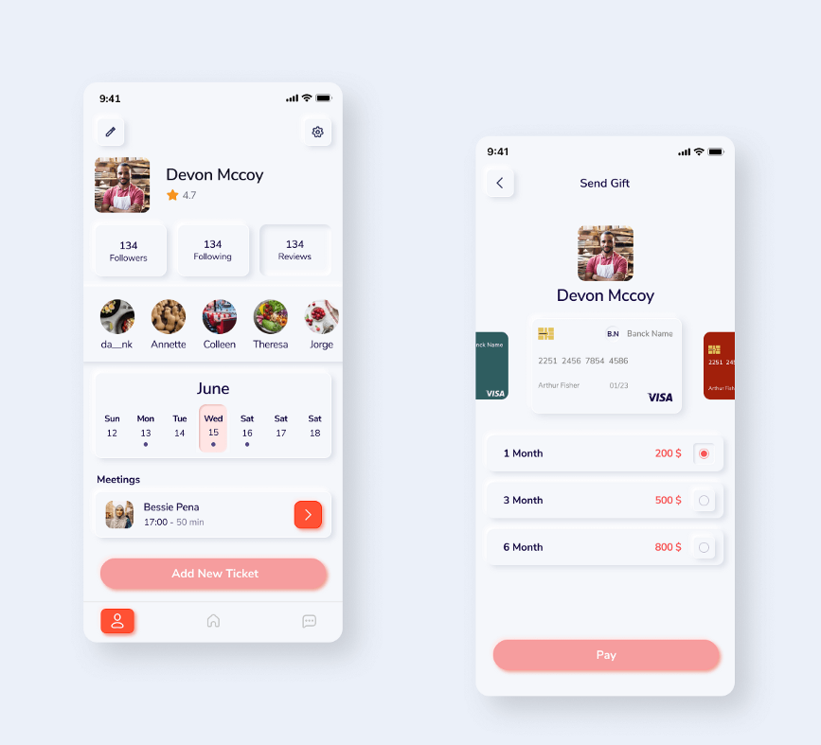
The 3 Ways
3. Neumorphism
Interface that
simulates
Neumorphism.

Slide 28
Color palettes and mood psychology
Color plays a vitally important role in the world in which we live.
Color can sway thinking, change actions, and cause reactions. It can irritate or soothe your eyes, raise your blood pressure or suppress your appetite.
When used in the right ways, color can even save on energy consumption.

Slide 29
Color palettes and mood psychology
The importance of picking the right colors should be considered heavily.
Especially in mobile application. We use our phones on a daily basis.
How we use it or How often we use it
Affects our well-being

Slide 30
Color palettes and mood psychology
Based on a research, on average, Americans spend 2 hours, 54 minutes on their phones each day.
The average American will spend nearly a month and a half (44 days) on their phones in 2022.
Source: https://www.reviews.org/mobile/cell-phone-addiction/#:~:text=On%20average%2C%20Americans%20spend%202,on%20their%20phones%20in%202022.

Slide 31
Color palettes and mood psychology
Based on another research, people devote third of waking time to mobile apps.
Let’s do a test.
How many of you use your phones the first thing you wake up in the morning?
How many of you use your phones right before you go to bed?

Slide 32
Color palettes and mood psychology
In general, our smartphones becomes one of the main aspect of our lives and that’s where mobile developers need to have a basic understanding of color dynamics.

Slide 33
Color palettes and mood psychology

Slide 34
Color palettes and mood psychology
The color blue simulates:
Calmness
Serenity
Stability
Reliability

Slide 35
Color palettes and mood psychology
Is this test better?
Is this better?
Is this better?

Slide 36
Class Discussion 2.004
Look at examples of design styles within apps that you use day-to-day.
What style are they most similar to?
Do you have a preference for a particular style?
Upload your thoughts to the link below:
https://tinyurl.com/m9ftjj28

Slide 37
Dark Patterns
The term “dark patterns” was first coined by UX specialist Harry Brignull to describe the ways in which software can subtly trick users into doing things they didn’t mean to do, or discouraging behavior that’s bad for the company.
One big example would be unsubscribing to any services.

Slide 38
Dark Patterns
When you want to unsubscribe from a mailing list, but the “Unsubscribe” button is tiny, low-contrast, and buried in paragraphs of text at the bottom of an email.
It’s a strong sign the company is putting up subtle roadblocks between you and cancellation.

Slide 39
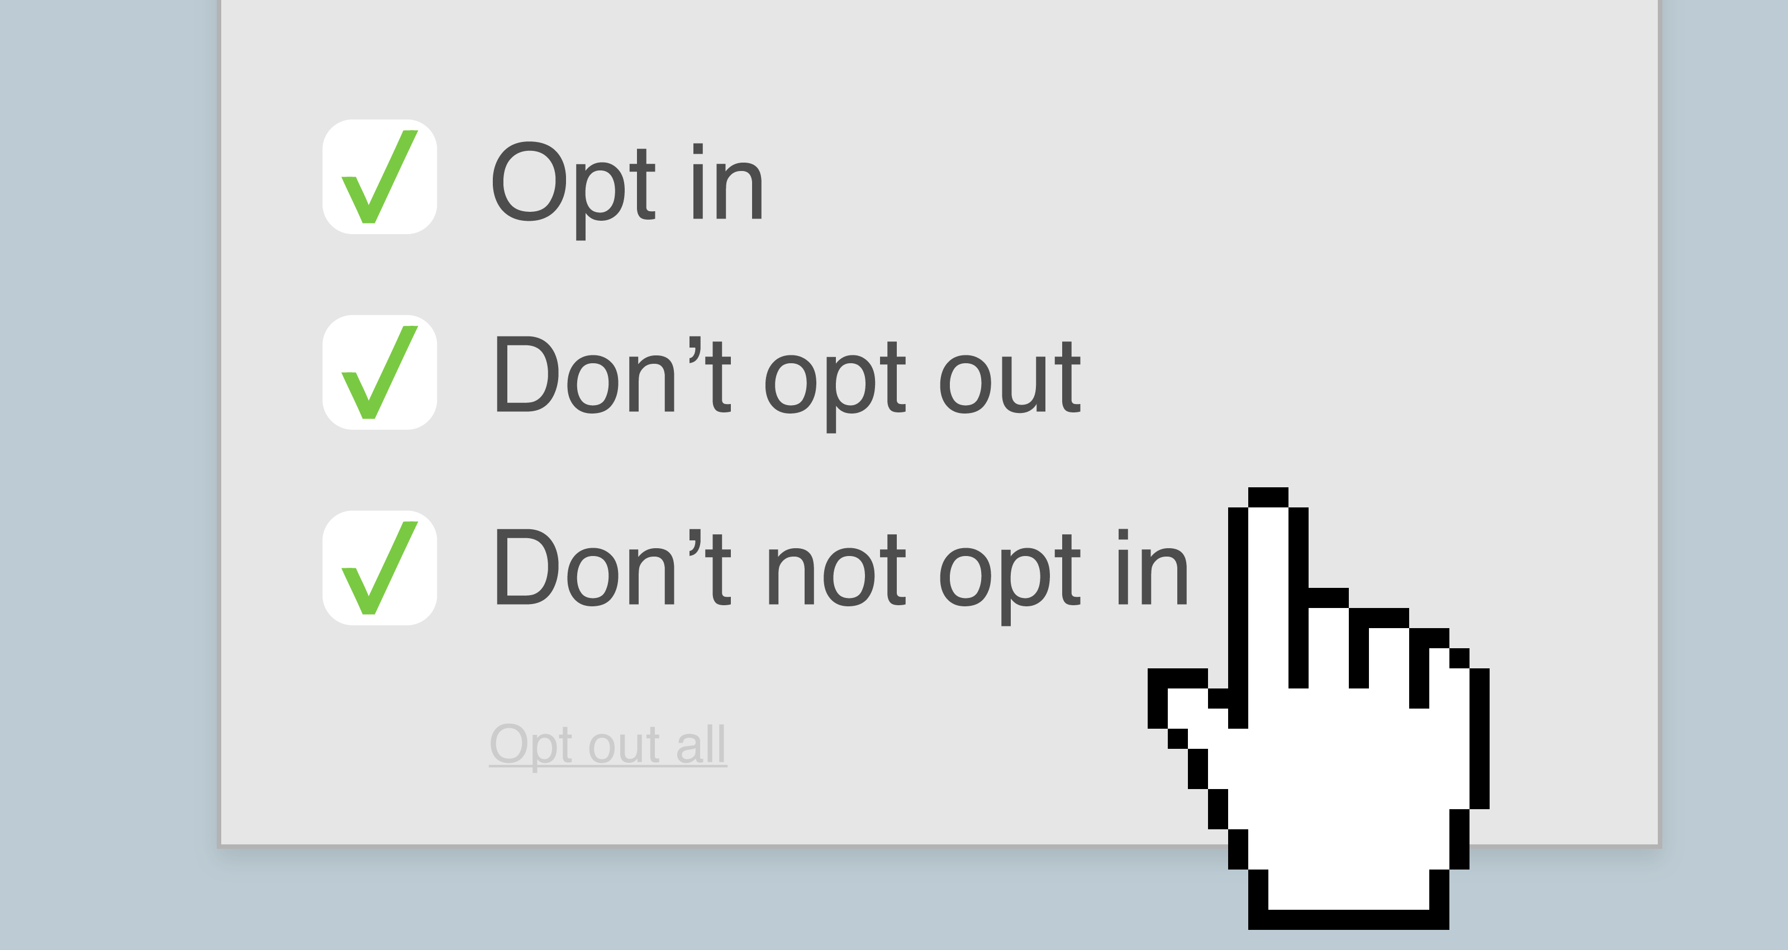
Dark Patterns
Take a look at this:

Slide 40
Dark Patterns
Interesting read!
10 common dark patterns in UX and how to avoid them:
https://www.netsolutions.com/insights/dark-patterns-in-ux-disadvantages/#:~:text=What%20is%20an%20example%20of,the%20common%20dark%20UX%20examples.

Slide 41
Wireframing
Mobile application wireframes tend to be compared to the classic blueprints for any construction project.
It delivers a clear picture of how things are going to look, in broad strokes.

Slide 42
Wireframing
They are meant to be a practical map, so everyone can see exactly what goes where inside the project.
They can be incredibly handy in terms of both product development and communication – aside from being relatively cheap to build.

Slide 43
Wireframing
TWO (2) types of Wireframes.
Low-Fidelity Wireframes
High-Fidelity Wireframes

Slide 44
Wireframing
Low-Fidelity Wireframes
Low-fidelity wireframes tend to have rough layout schemes that show the general localization of each element on the screen, but don’t show us details of what those elements will look like.

Slide 45
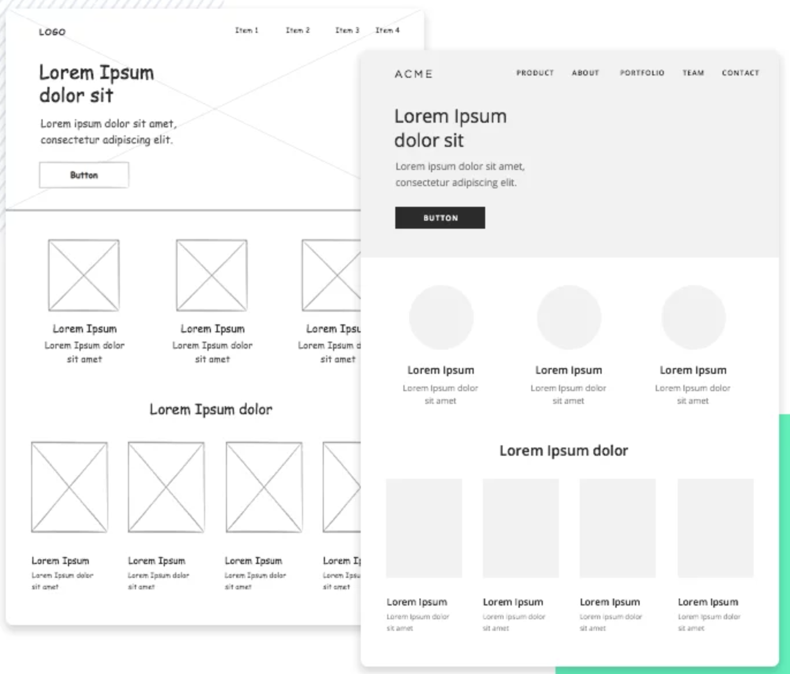
Wireframing
Low-Fidelity Wireframes

Slide 46
Wireframing
Low-Fidelity Wireframes
Instead, the screen is likely to be divided into zones or blocks, with little attention being paid to scale or accuracy.
It’s better to go with a low-fidelity mobile wireframe if you have several concepts you want to play with and compare within a tight time-frame.

Slide 47
Wireframing
High-Fidelity Wireframes
High-fidelity wireframes tend to vary a lot depending on the company and design team.
Some use real images and real content, even including many of the interactions the design will have.
But this comes at the cost of investing lots of time into creating and adding all these details, making them better suited for later stages of the creative process.

Slide 48
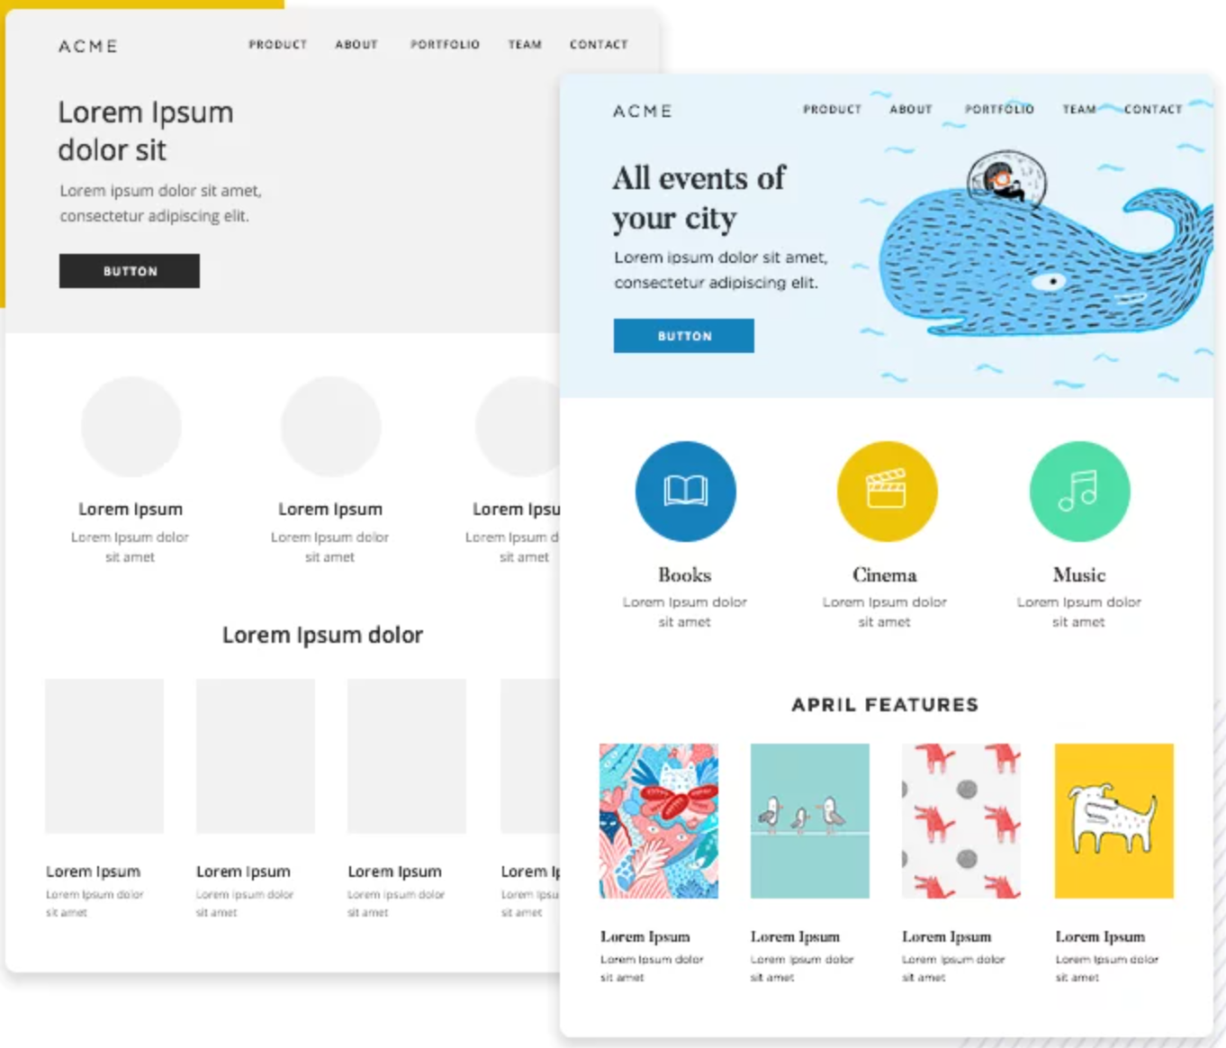
Wireframing
High-Fidelity Wireframes

Slide 49
Wireframing
High-Fidelity Wireframes
It’s important to note that one should never start off straight with a high-fidelity mobile application wireframe.

Slide 50


Wireframing
https://www.invisionapp.com/
Sketch
https://www.sketch.com/

Slide 51
Wireframing
Inivison Overview Video Link:
https://www.youtube.com/watch?v=vTgKtoU--Z8&t=9s&ab_channel=InVision
Inivison Tutorial Video Link:
https://www.youtube.com/watch?v=x2Ra-46H0Rk&ab_channel=ParkerRex

Slide 52
2.301 Graded Assessment Wireframing
Creating a wireframe for a hotel booking app.
In this assignment, we will make wireframes and user flow diagrams for a fictional hotel booking application.
You can use any wireframing tool that provides mid-fidelity wireframing, and you need to submit the image files as .jpg files.

Slide 53
2.301 Graded Assessment Wireframing
Creating a wireframe for a hotel booking app.
You need to produce FOUR(4) wireframe screens (details below) and a user flow diagram to connect them. You don't need to program the UI, you only submit wireframes.
You can use other real hotel booking apps as inspiration.
However, try not to copy them 1:1; there are often many improvements that you can make to pre-existing apps! We’re looking for sensible but unique wireframes.

Slide 54
2.301 Graded Assessment Wireframing
Creating a wireframe for a hotel booking app.
Home screen
This should include a search box including location, number of adults, children and number of rooms. It should also include some ‘featured’ properties which have an image, a title and a location.

Slide 55
2.301 Graded Assessment Wireframing
Creating a wireframe for a hotel booking app.
Search results screen
This should include a header including the search location, some refining elements that allow you to adjust the search radius and the series of matching properties - each with its own rating, name, location and price per night.

Slide 56
2.301 Graded Assessment Wireframing
Creating a wireframe for a hotel booking app.
Details screen
This is for when a user taps on a property to view more. You should have images of the property, extended details, including a description and a book now button.

Slide 57
2.301 Graded Assessment Wireframing
Creating a wireframe for a hotel booking app.
Settings screen
A simple setting screen that contains any essential settings for a user’s account.

Slide 58
2.301 Graded Assessment Wireframing
Creating a wireframe for a hotel booking app.
A user flow diagram
Connecting the above wireframes together.

Slide 59
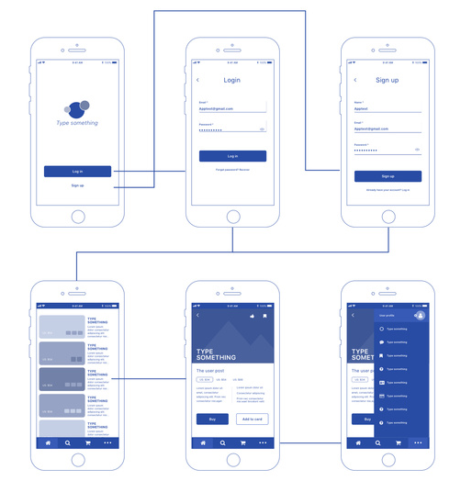
2.301 Graded Assessment Wireframing
Creating a wireframe for a hotel booking app.
A user flow diagram
(Example)

Slide 60
That’s all for today!
If you have any questions, please feel free to reach out to me at this email.
kydsim001@mymail.sim.edu.sg
Notes:
B

Slide 61
END OF LESSON

